Slide 1
Practical II
Monday/Tuesday, 30/31 January 2023, 2pm – 5pm
Department of Biology, University of Oxford

Slide 2
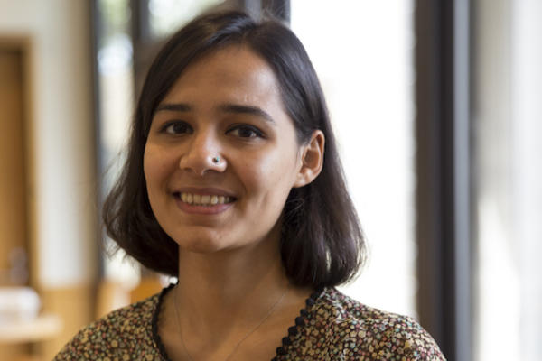


Demonstrators/Instructors
Sumali, (she/her)
Main research: Equity in disease transmission and statistical inference
Rhys, (he/him)
Main research: Genomic epidemiology and sampling biases
Moritz, (he/him)
Main research: Spatio-temporal dynamics of infectious diseases

Slide 3
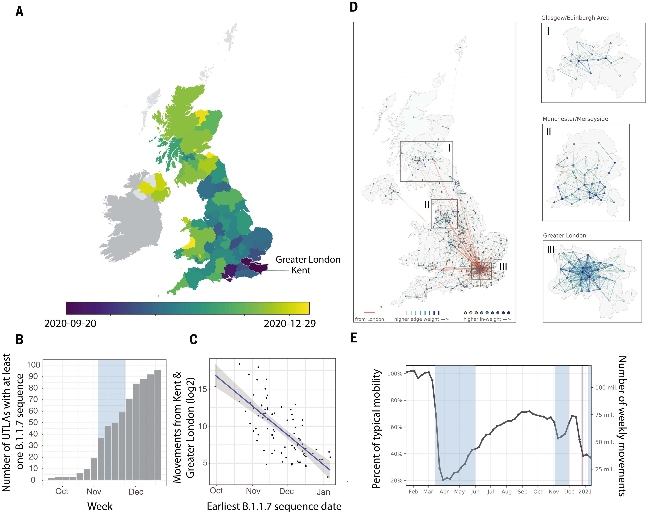
What are we learning today?
Spatio-temporal dynamics of plant and infectious diseases
How to fit multiple models to data and evaluate which ones explain the data best (for plant diseases)
Differences between human mobility driven dispersal vs. continuous diffusion
How to incorporate spatial structure in epidemic models (flu again)
Kraemer et al. 2021 Science

Slide 4
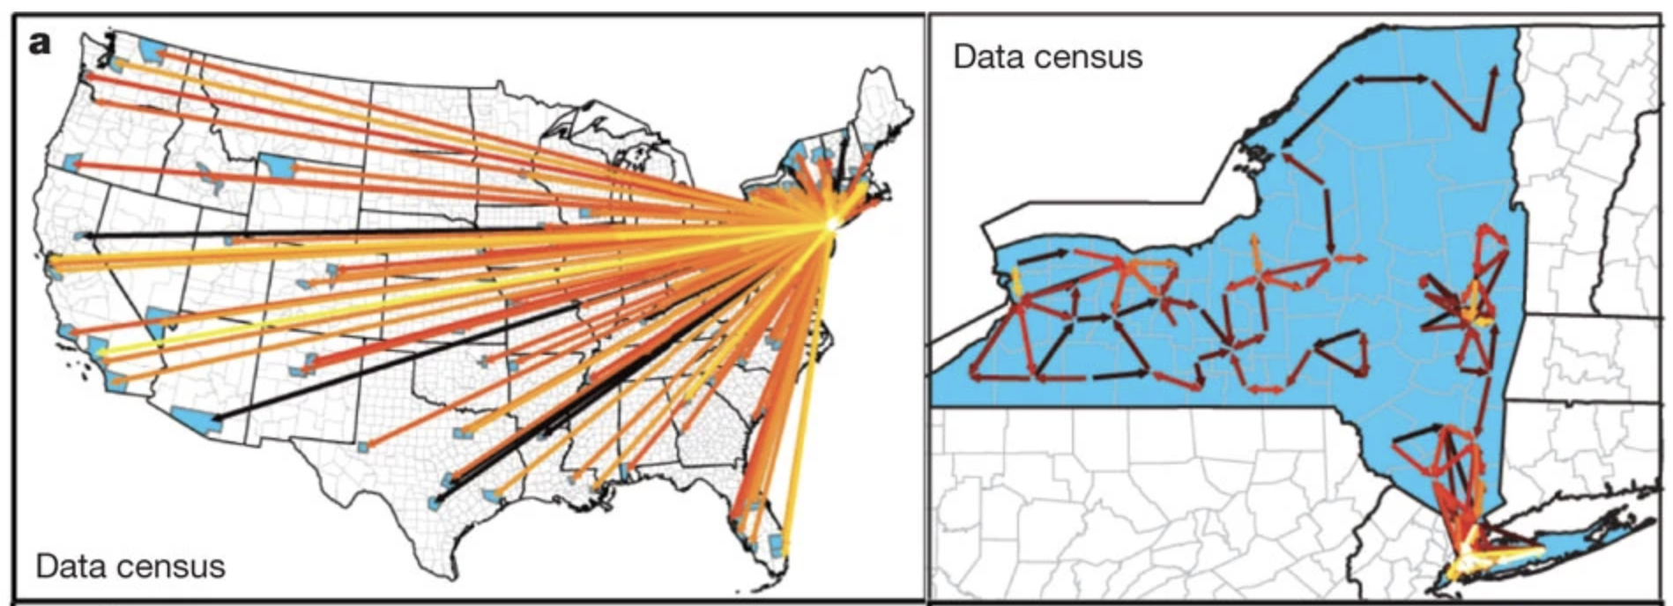
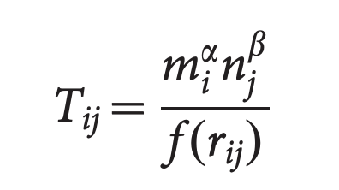
Models of human mobility
Infectious diseases spread along human movement networks
Challenge: how do we represent human movement in ID models?
The gravity model
Simini et al. 2017 Nature

Slide 5
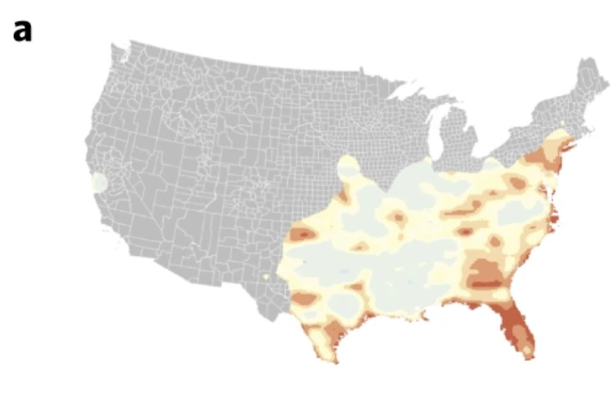
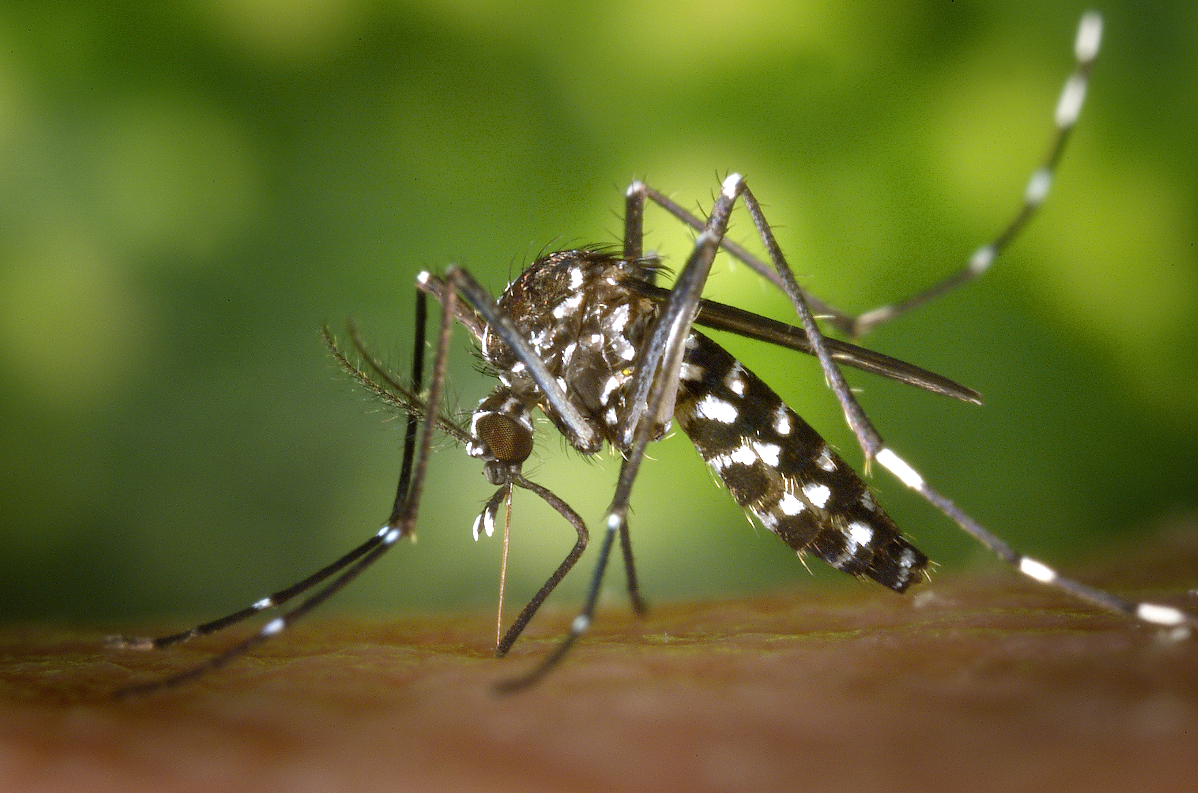
Examples of continuous diffusion
Aedes albopictus dispersal in the US
Kraemer et al. 2019 Nat. Microbiology
https://en.wikipedia.org/wiki/Aedes_albopictus

Slide 6
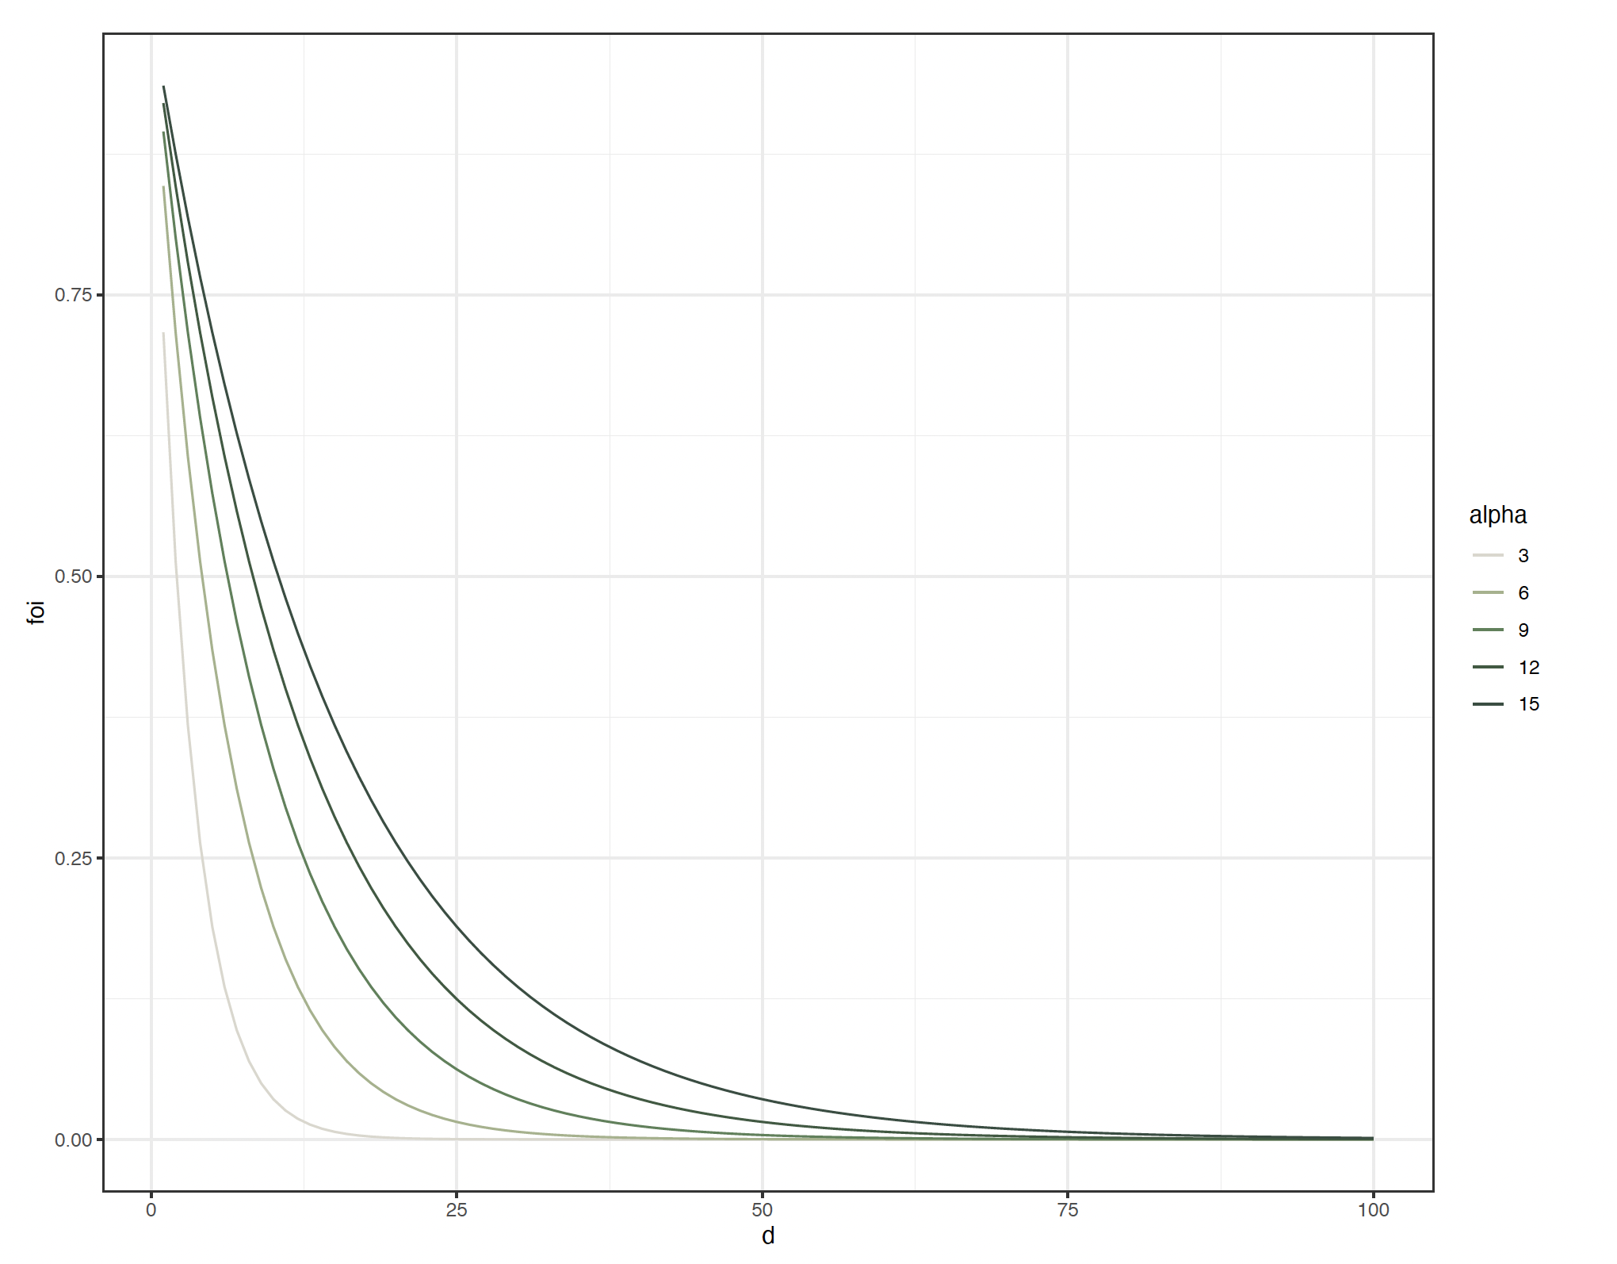
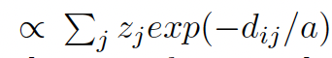
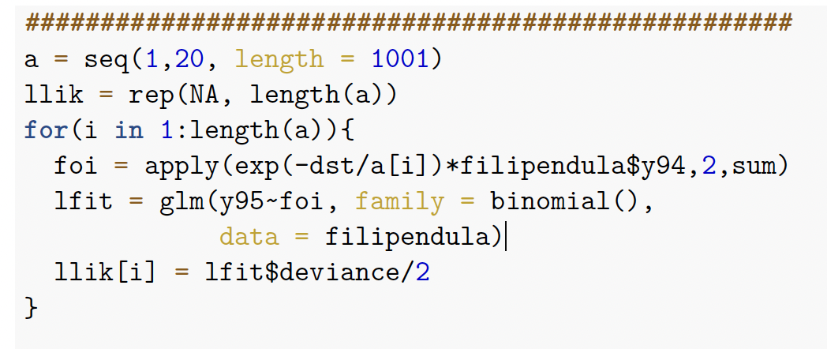
Spatial force of invasion

Slide 7
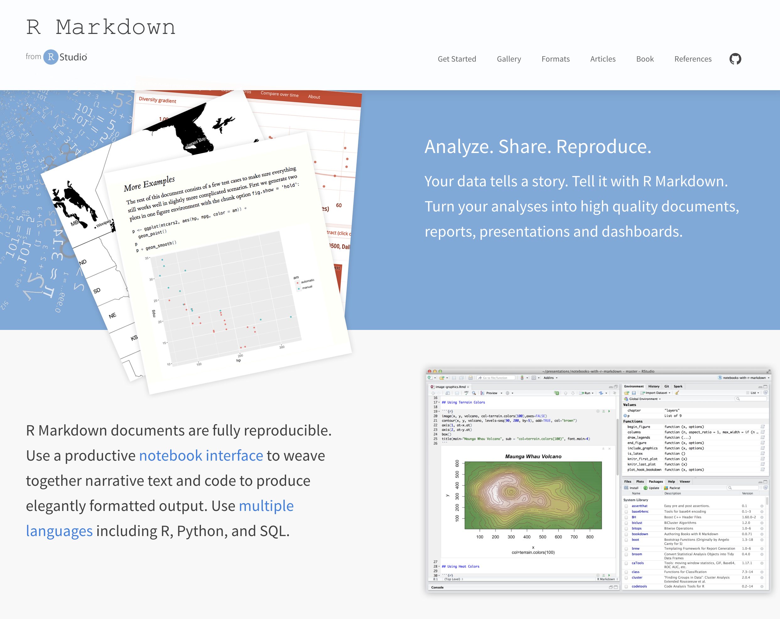
R-Markdown (again)
Please create your own R-Markdown
https://rmarkdown.rstudio.com/

Slide 8
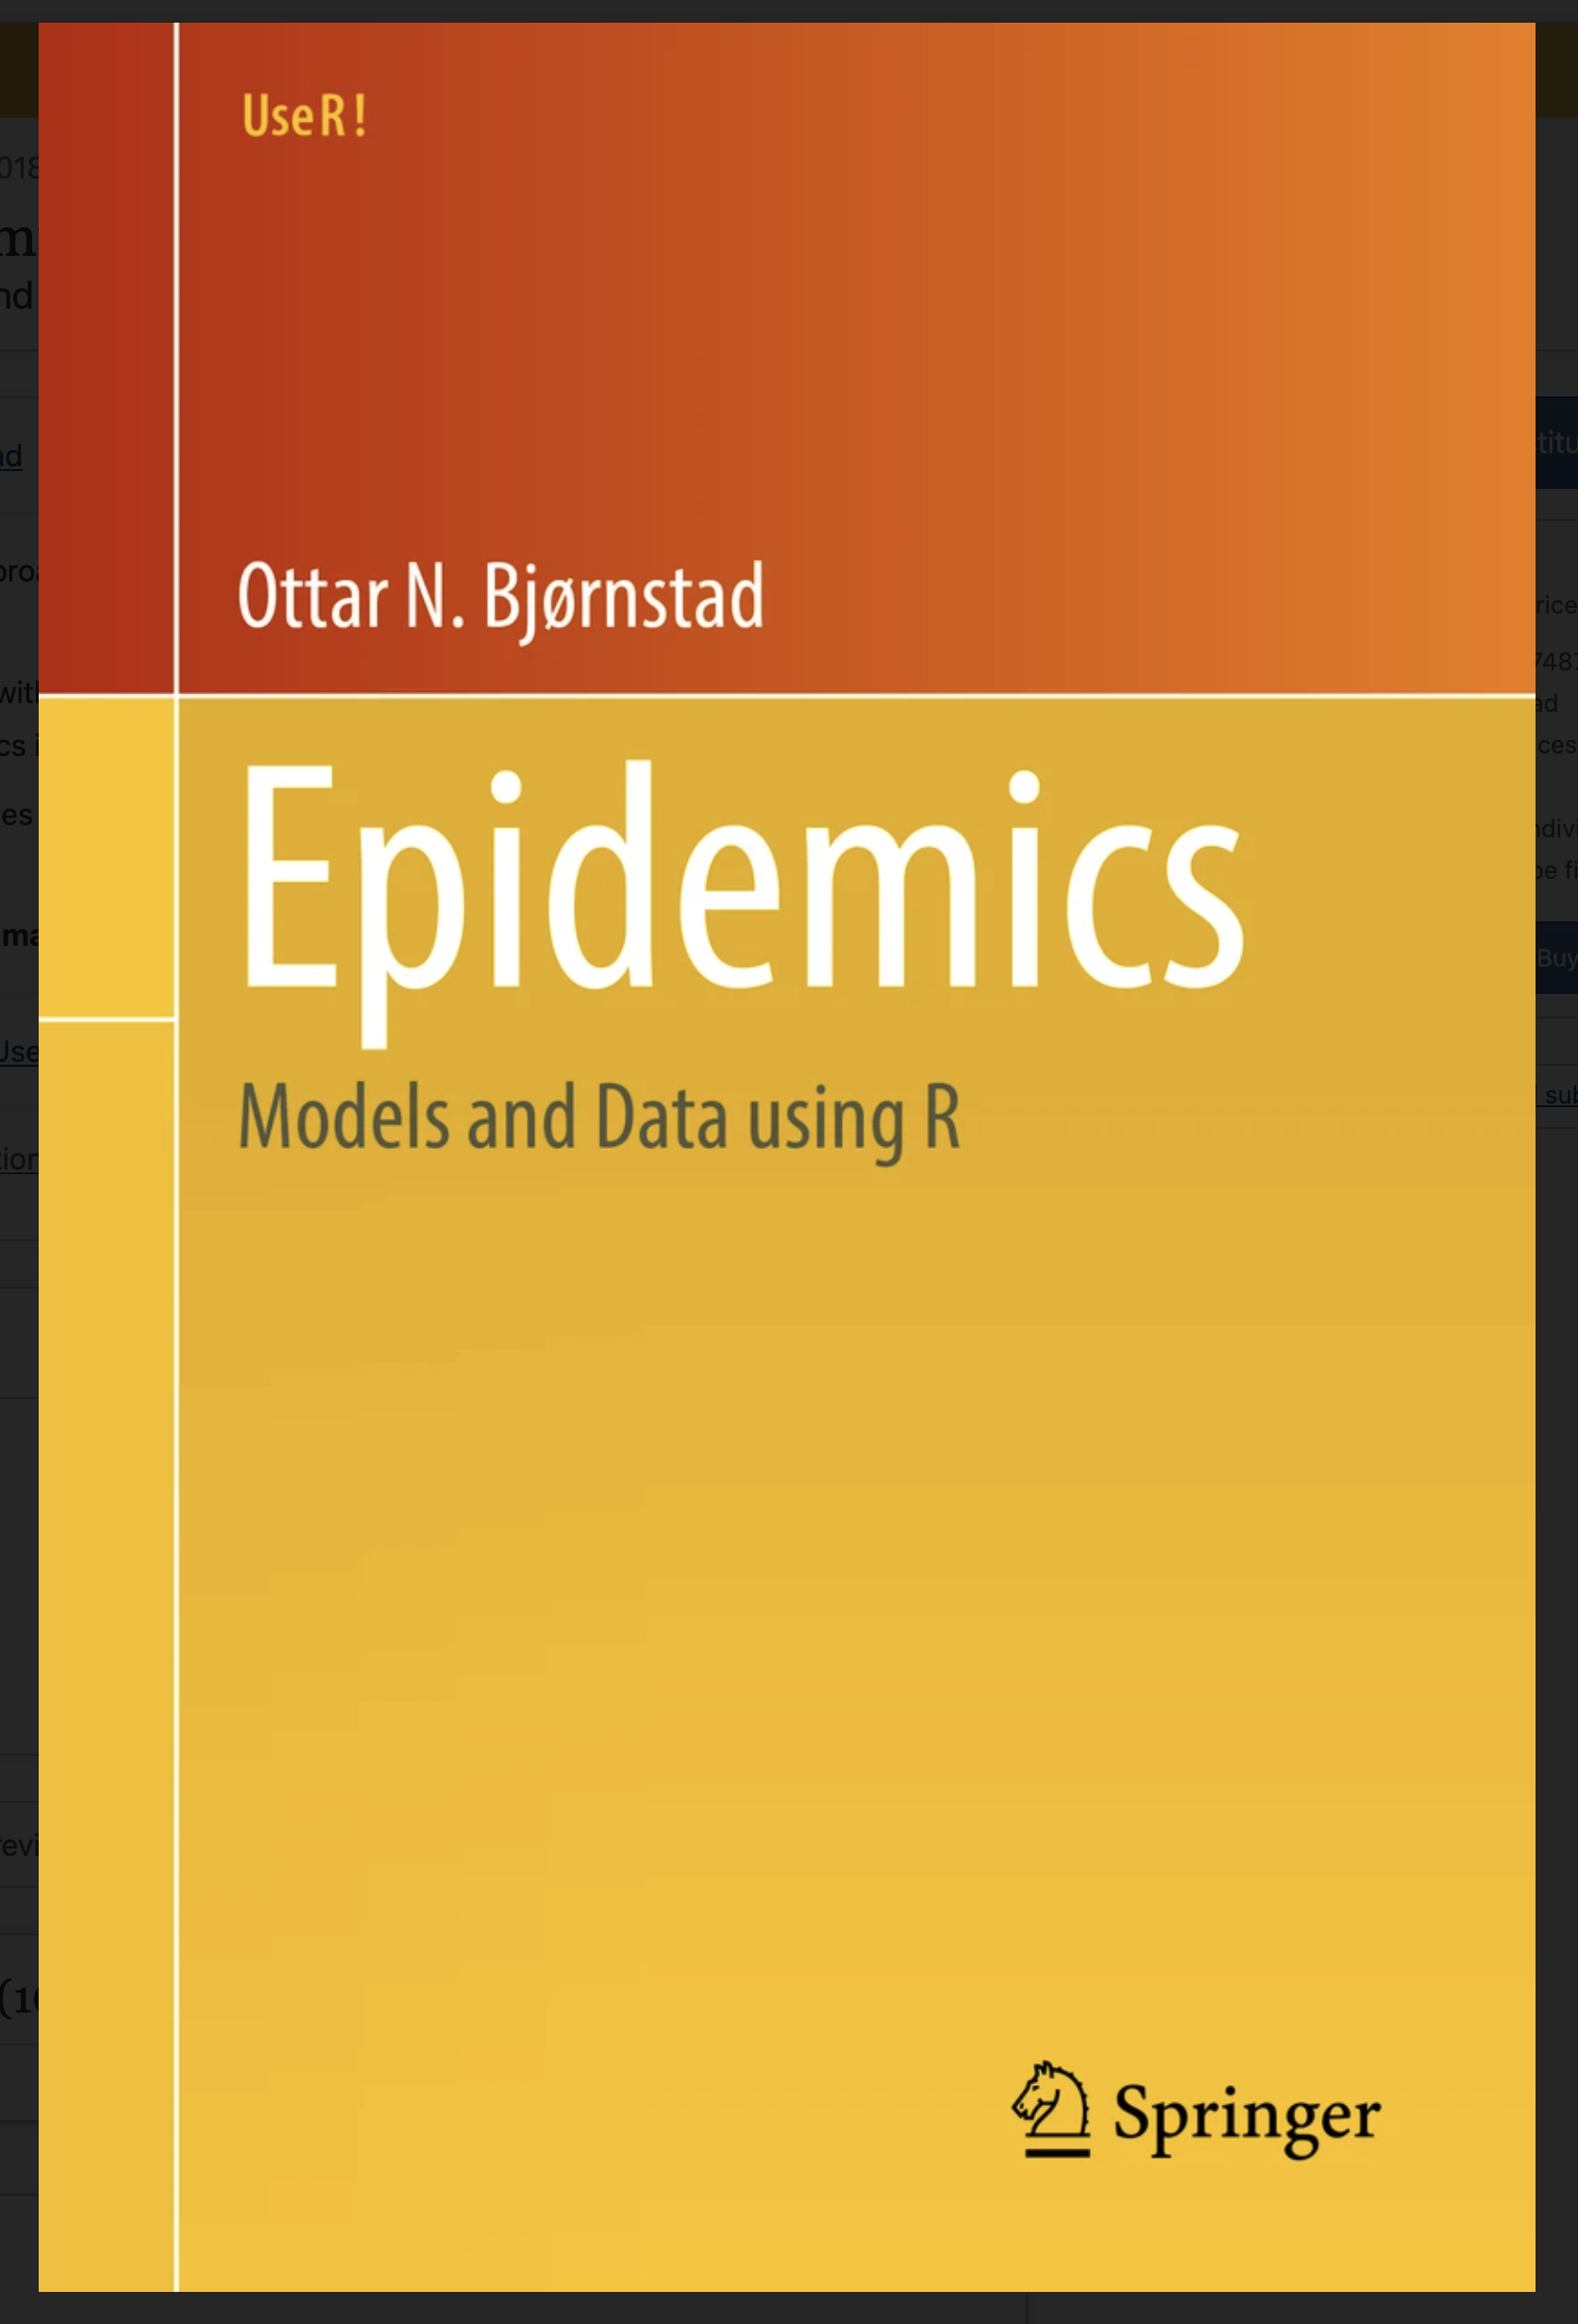
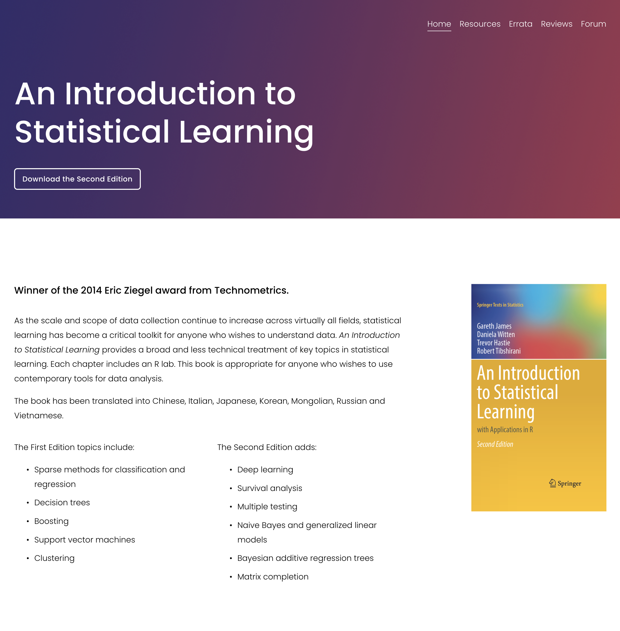
Some further readings
https://link.springer.com/book/10.1007/978-3-319-97487-3
https://www.statlearning.com/

